Slide 1
Calculator
Team Pi-Sense
Lochana Abhayawardana, Arsany Girgis and Emirkan Sali

Slide 2
Introduction

Slide 3
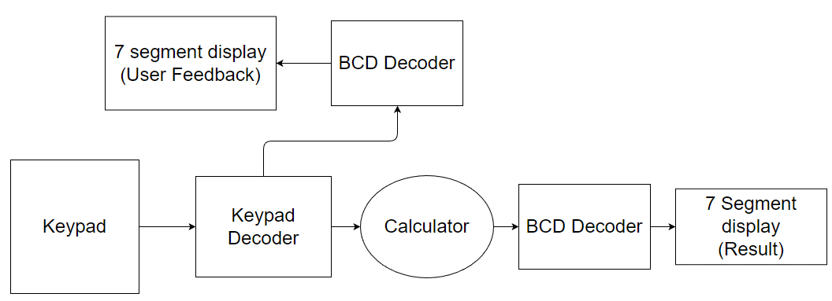
Block Diagram

Slide 4
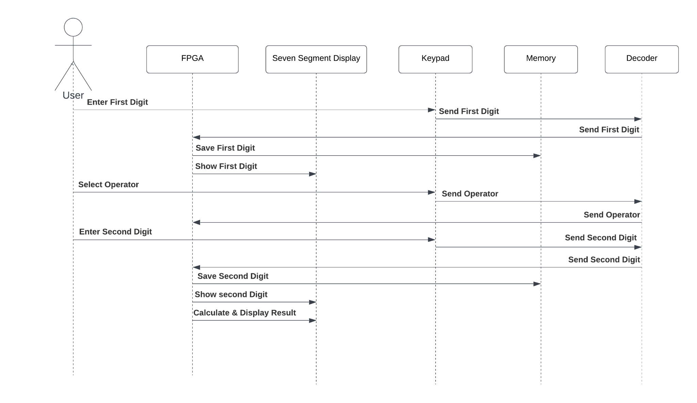
Sequence Diagram

Slide 5
Implementation

Slide 6
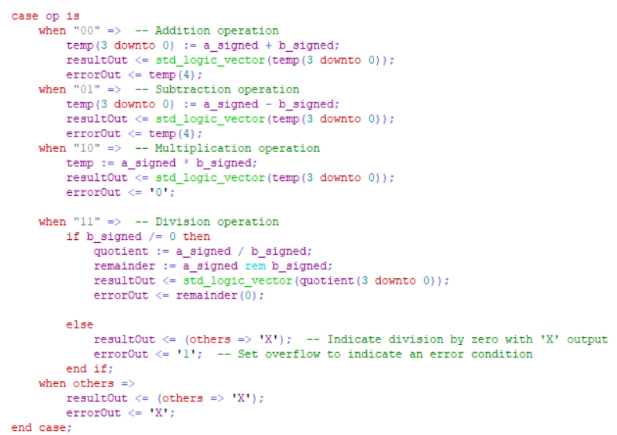
Calculator

Slide 7
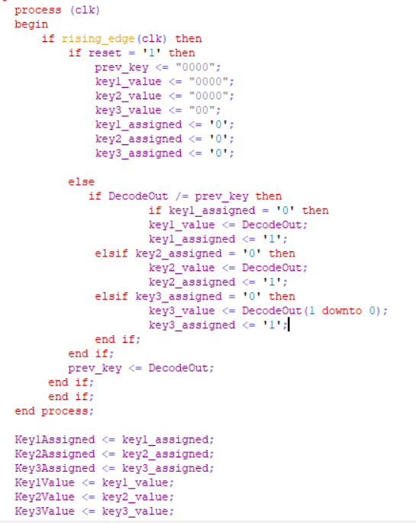
Decoder FSM

Slide 8
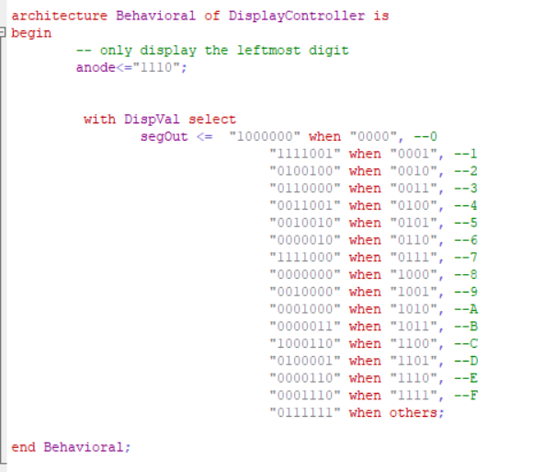
Display

Slide 9
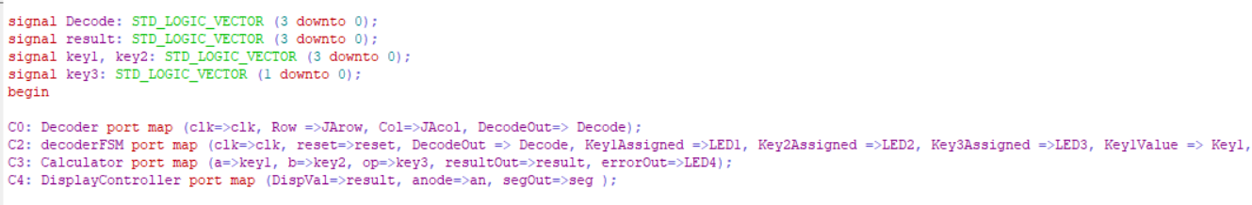
Top module

Slide 10
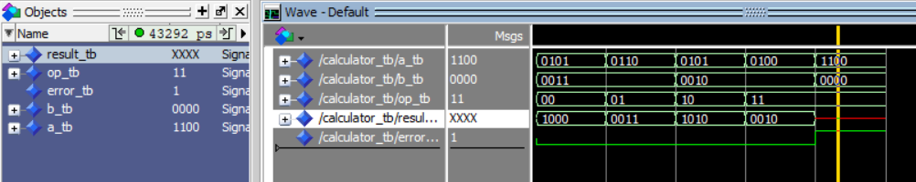
Calculator testbench

Slide 11
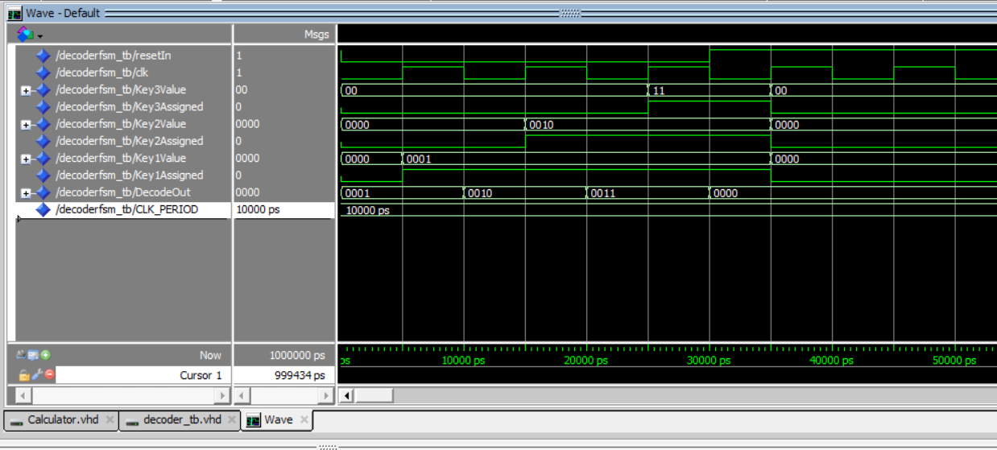
Decode FSM testbench

Slide 12
Schematic
Root page consisting of 5 subpages
Power page with Power supply, switch and LED
Keypad Page where we simulated the keypad using pushbuttons
FPGA page with the needed components of the FPGA
Seven segment display page with both displays
FPGA JTAG page for the JTAG Interface

Slide 13
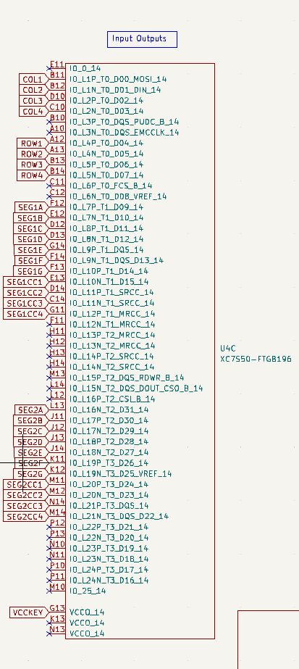
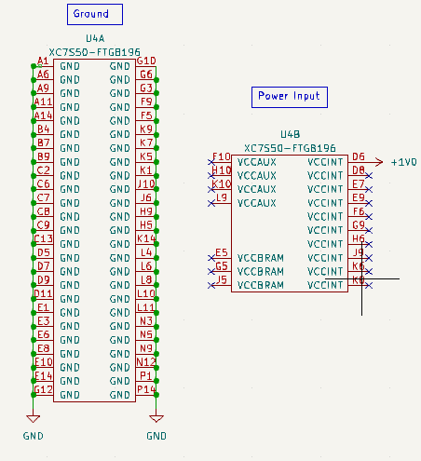
FPGA Components in the schematic

Slide 14
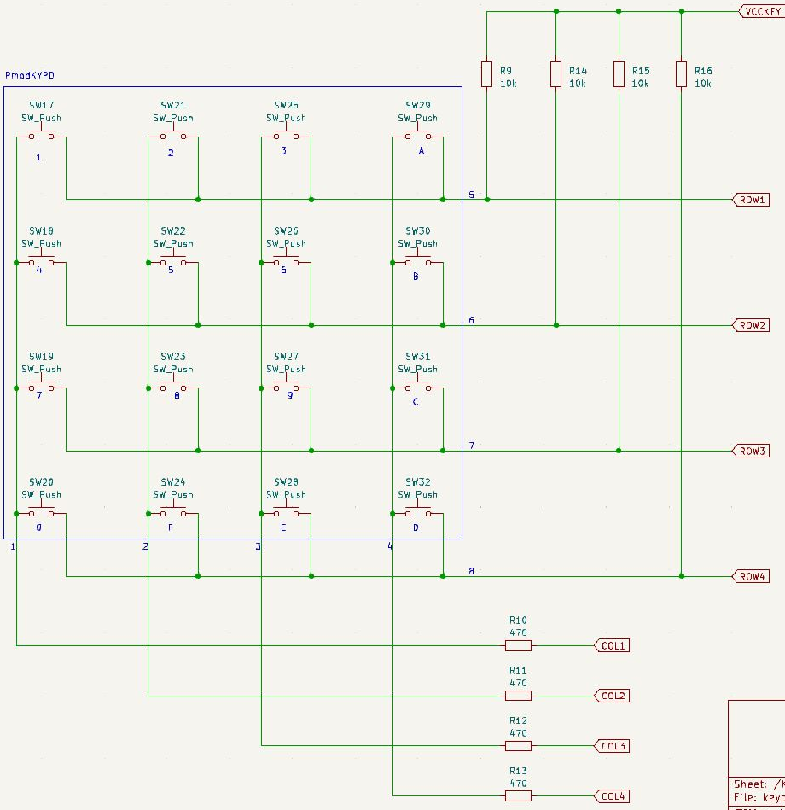
Keypad using push-buttons

Slide 15
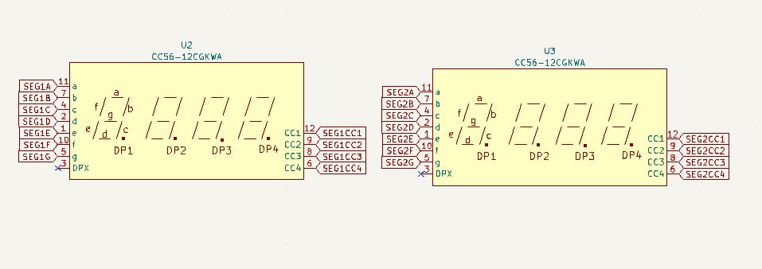
Seven Segment displays connected to the I/O ports of FPGA

Slide 16
PCB Design
Selecting the right footprints for the symbols
Arranging the components in a way that makes sense
Labeling, designing etc.
Routing of connections using Autorouter

Slide 17
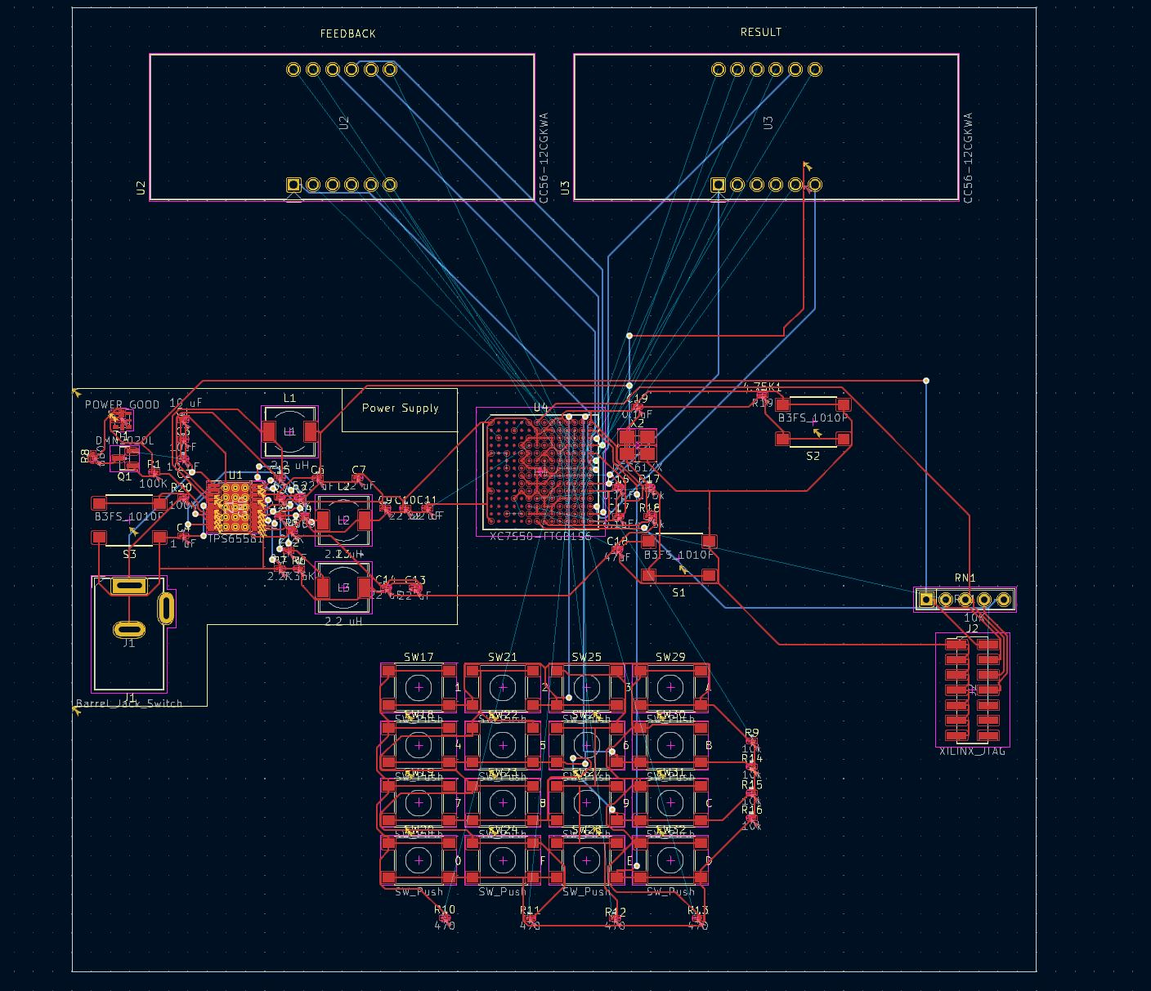
PCB layout with all its layers visible

Slide 18
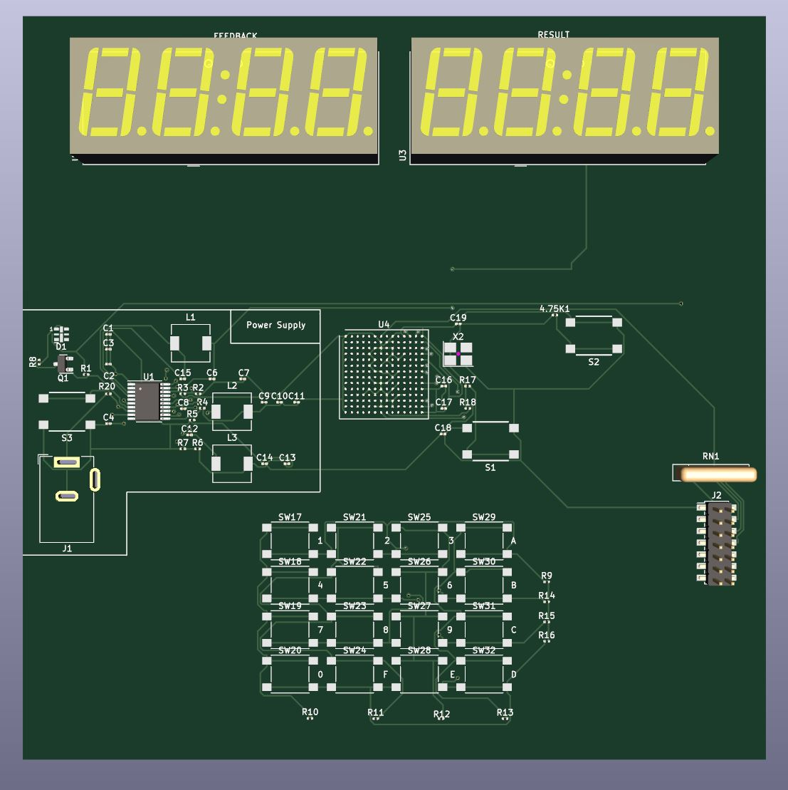
3D View of the PCB

